Slide 1

“…IT had a feeling…”

Slide 2

“…and then the sh*t hit the fan…”

Slide 3

“…data leaking EVERYWHERE…”

Slide 4

“…wait, you bought WHAT…?!”

Slide 5
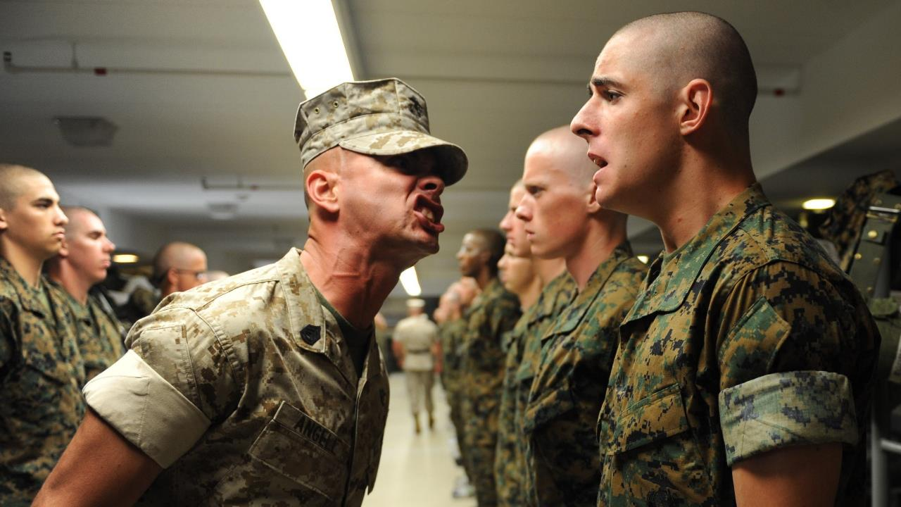
“…and then management had enough…”

Slide 6
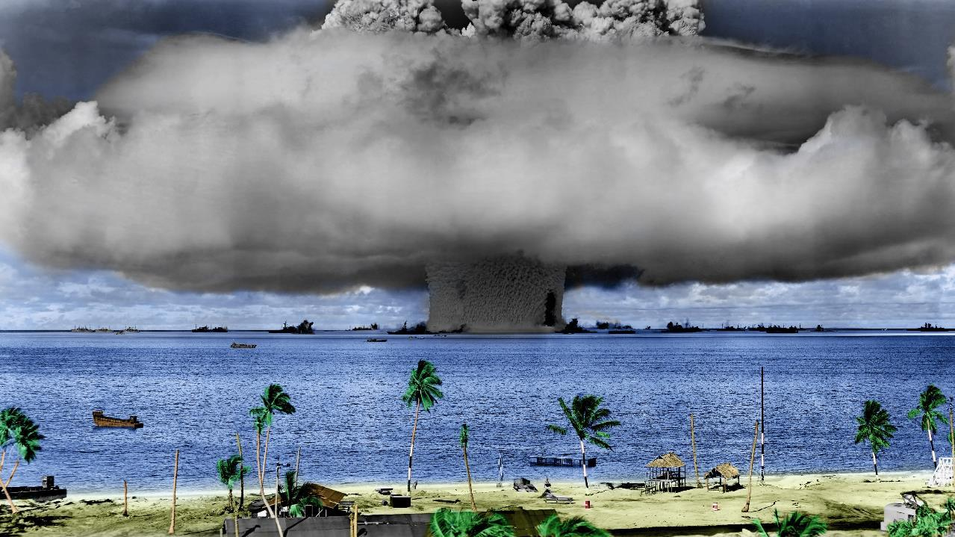
“… so the CEO laid down the law.”

Slide 7

FASTER time-to-market
SINGLE pane of truth
Secure SHARING
Optimized COSTS
Proper MONITORING

Slide 8
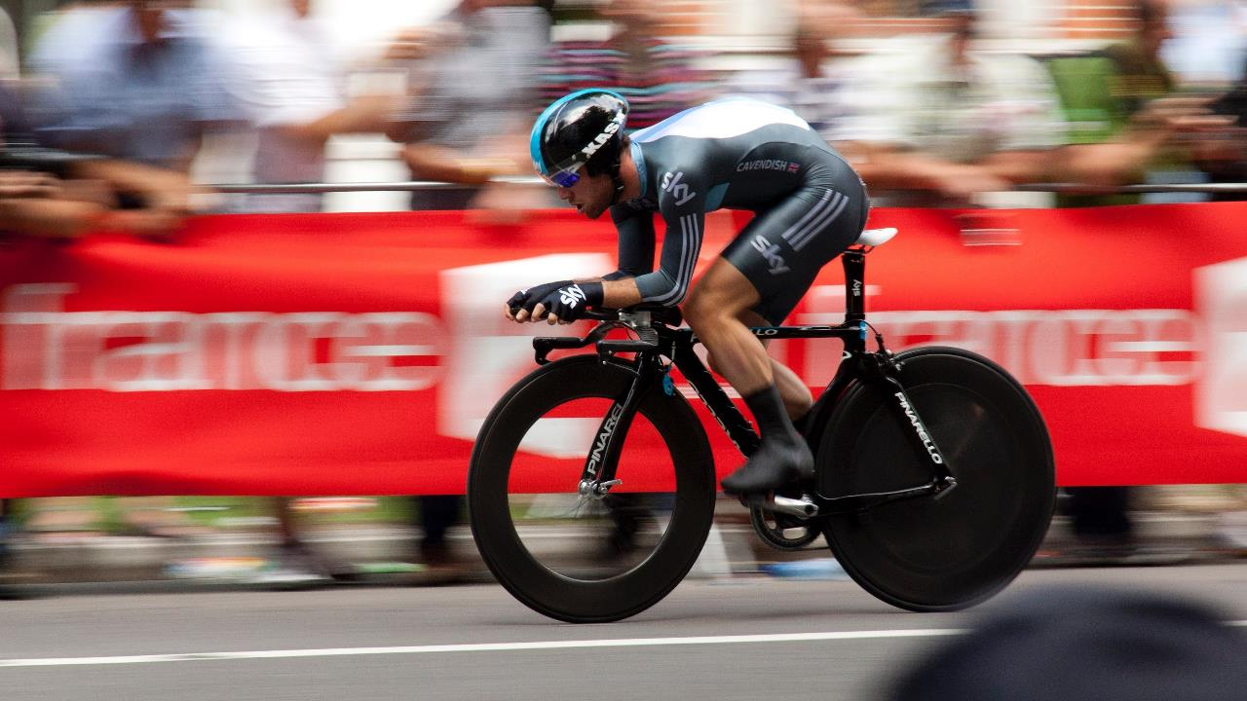

Slide 9









Slide 10


Slide 12


Slide 13


Slide 14


Slide 15
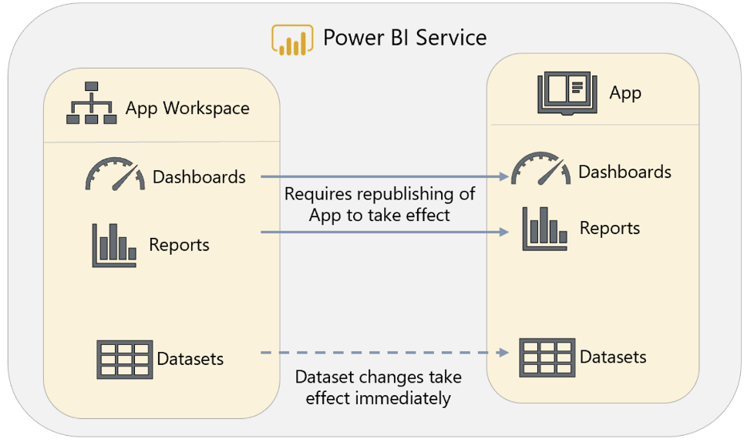



Slide 16


Slide 17



Shared capacity
Dedicated capacity
Pro
Free
Pro
Pro
Pro
Free
Pro
Free

Slide 18






=
$$

Slide 19
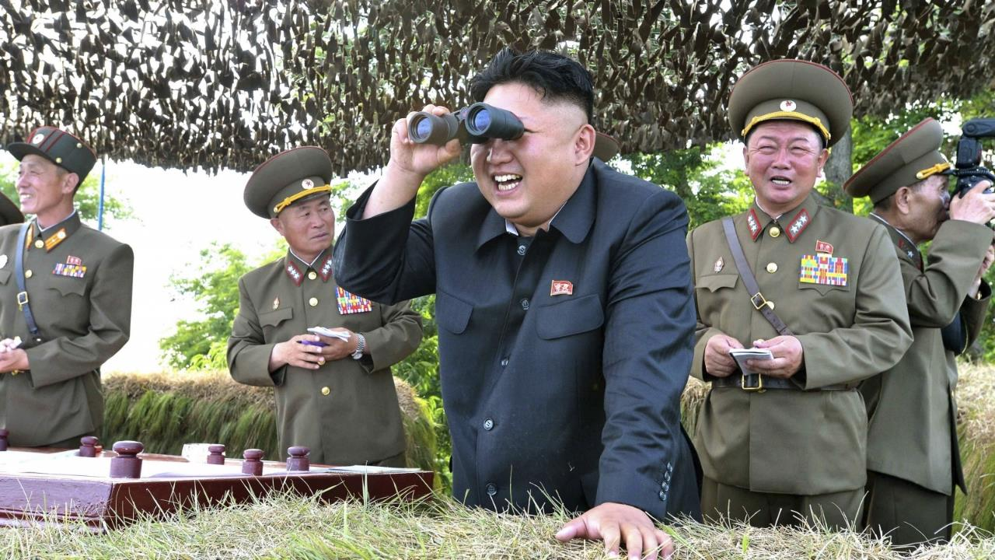

Slide 20
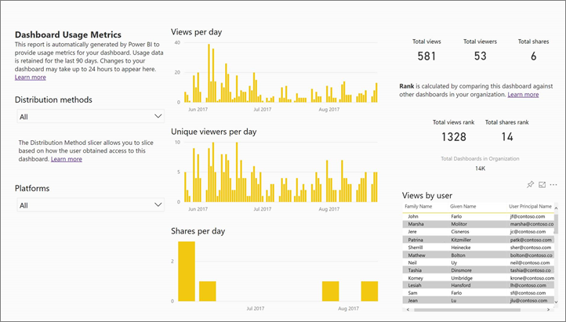

Slide 21
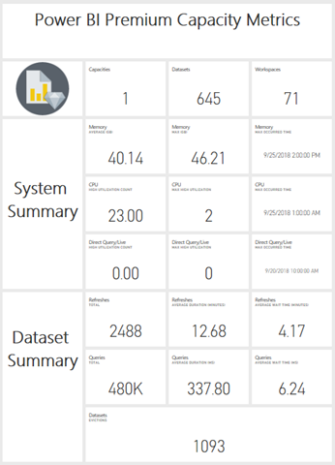

Slide 22
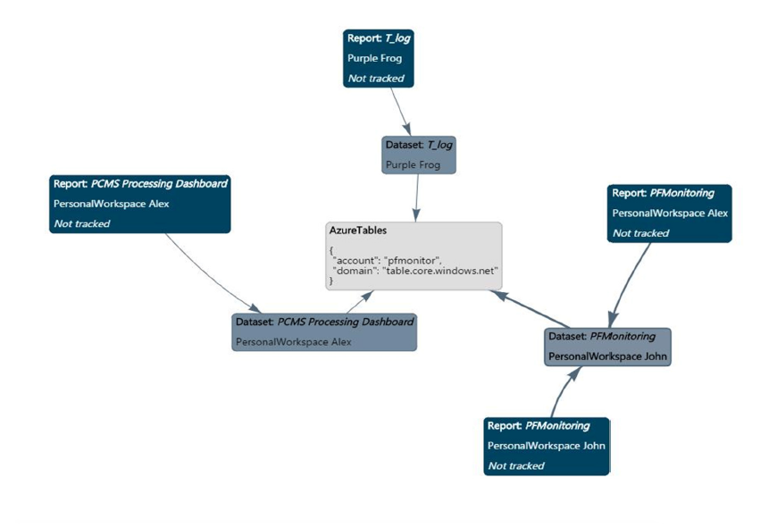

Slide 23
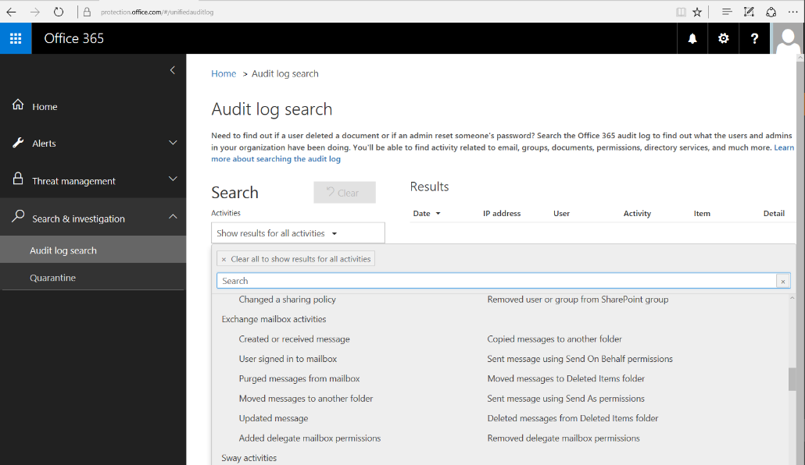

Slide 24
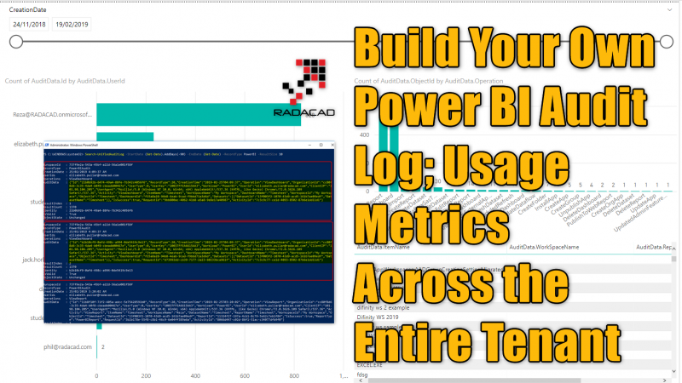

Slide 25
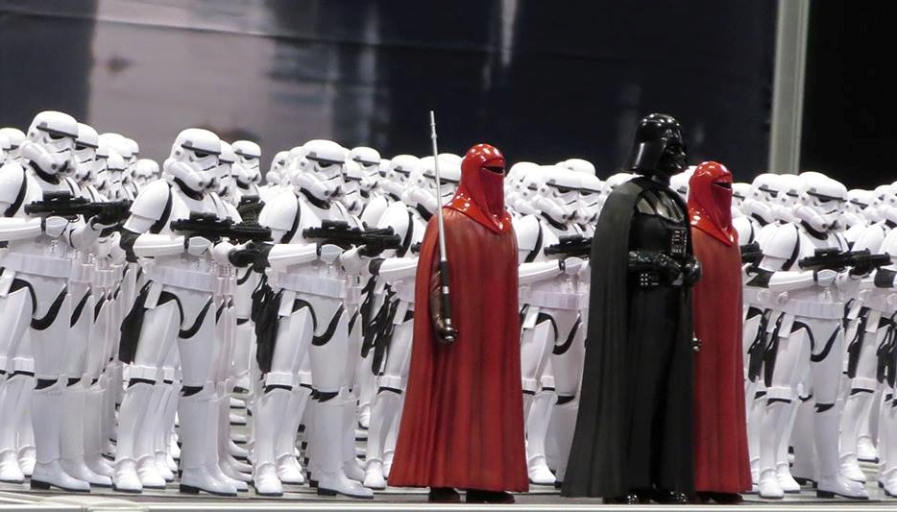
?
?
Frågor

Slide 26
LISTEN
to the business

Slide 27
Be part of the
SOLUTION

Slide 28
Combine your
TALENTS

Slide 29


Slide 30


Slide 31





Thank you!
https://www.kneedeepintech.com
@arcticdba
alexander@arcticdba.se
Knee-Deep in Tech

Slide 32

Session Feedback Day 2 (not optional!)
http://bit.ly/DataGrillen2019Day2

Slide 33

Event Feedback (not optional!)
http://bit.ly/DataGrillen2019Event

